Slide 1

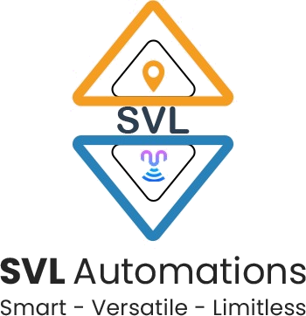
Internet of Things
Training Presentation

Slide 2

Topics
Introduction to boards and sensors
Types of boards and sensors
Features
Pin Configuration
Interfacing

Slide 3

Arduino Uno
https://docs.arduino.cc/hardware/uno-rev3/#tech-specs

Slide 4
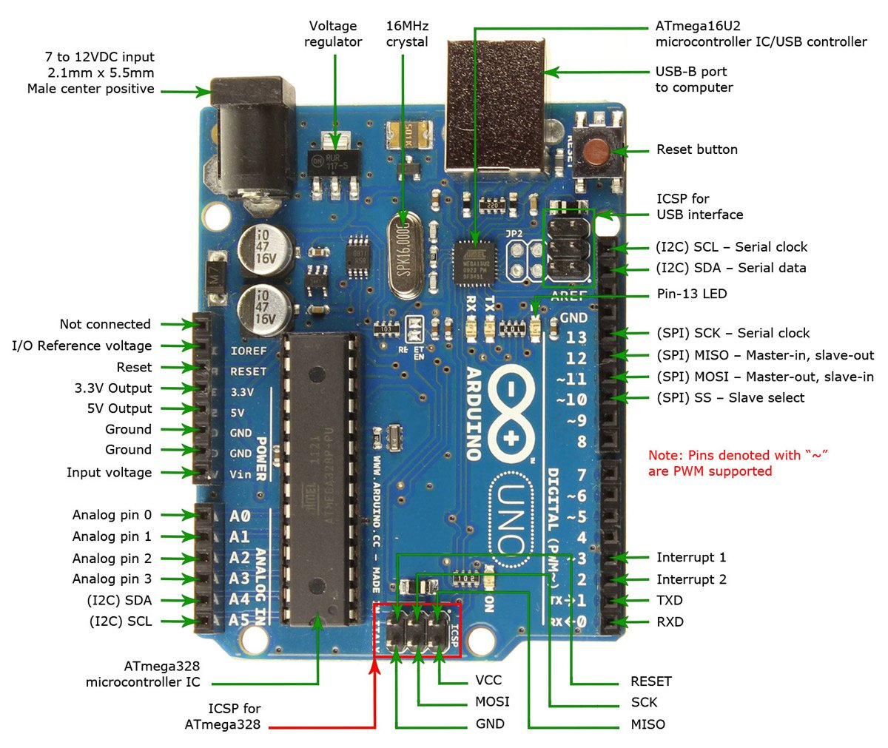

Slide 5
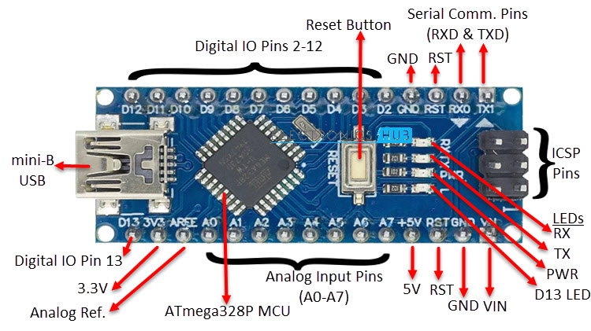
Arduino Nano
https://docs.arduino.cc/hardware/nano/#tech-specs

Slide 6
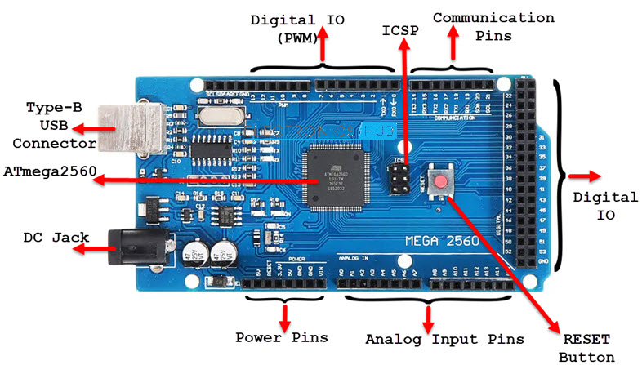
Arduino Mega
https://docs.arduino.cc/hardware/mega-2560/#tech-specs

Slide 7
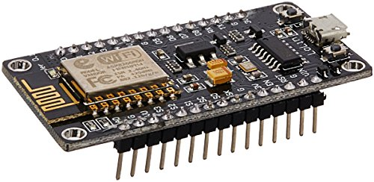
NodeMCU

Slide 8
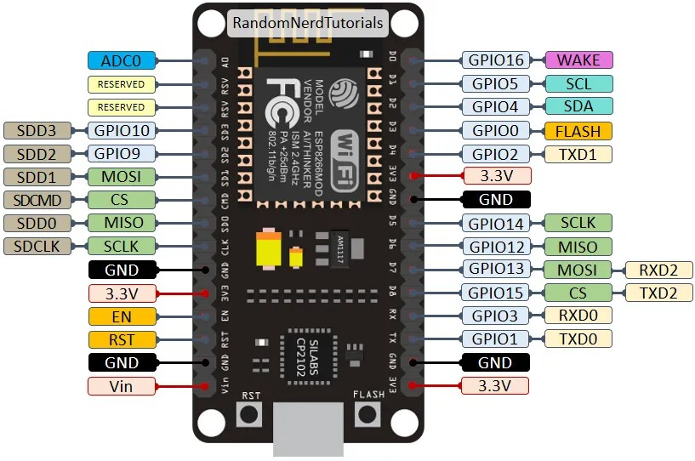
NodeMCU Pinout

Slide 9
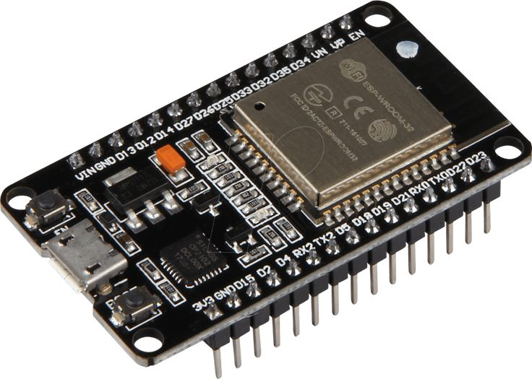
ESP32

Slide 10
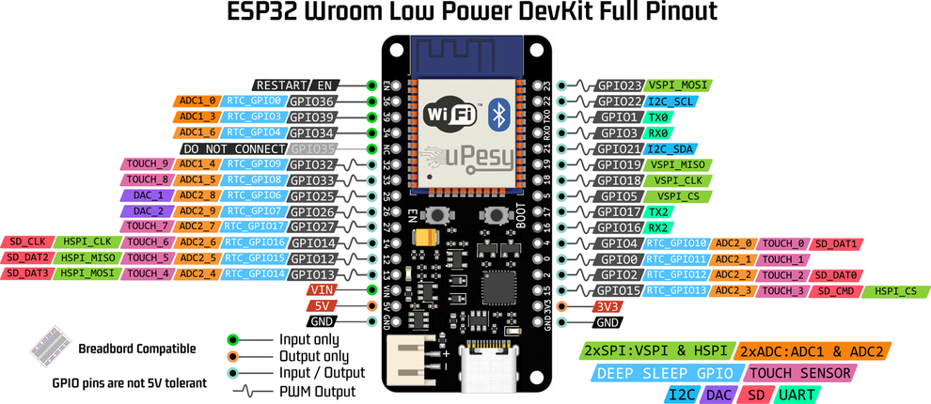
ESP32 Pinout

Slide 11
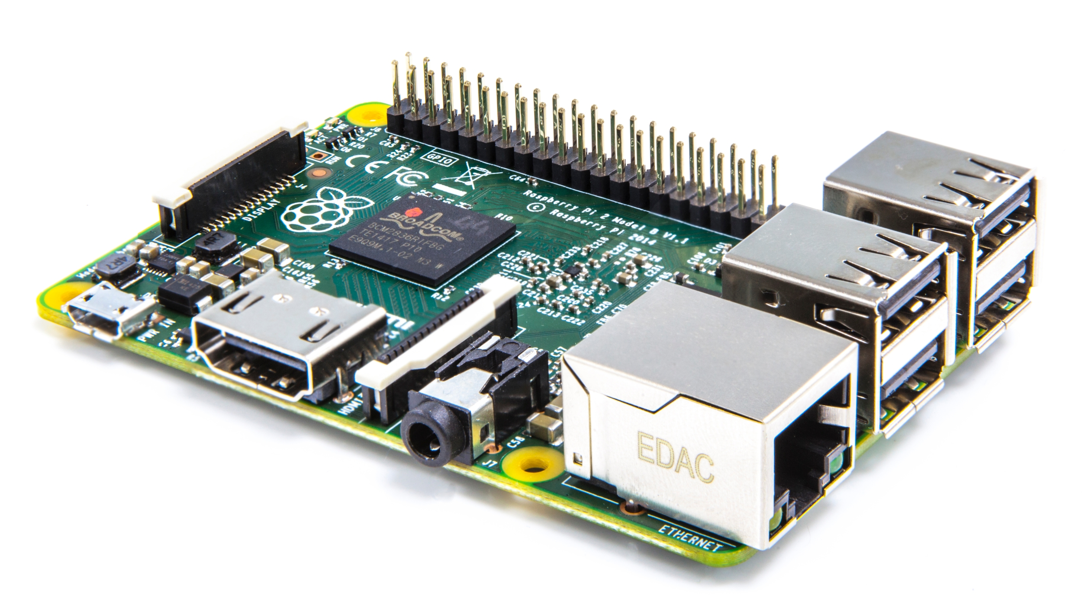
RaspberryPi

Slide 12
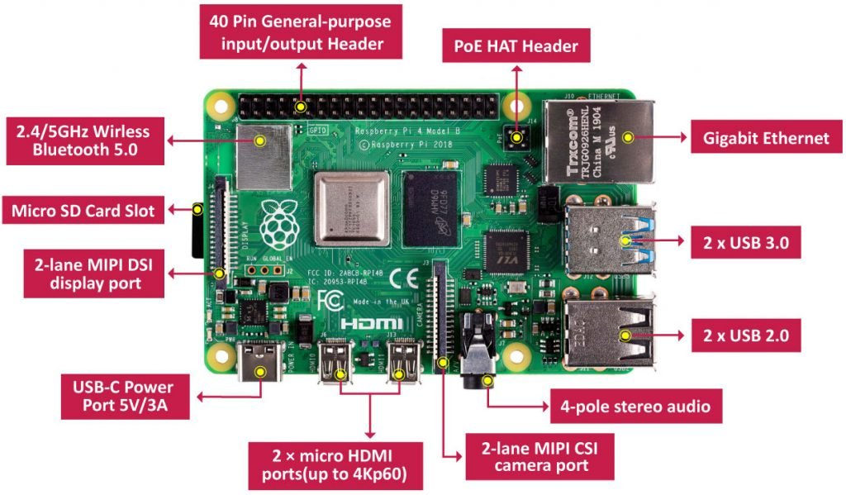
RaspberryPi

Slide 13

Introduction to Sensors

Slide 14

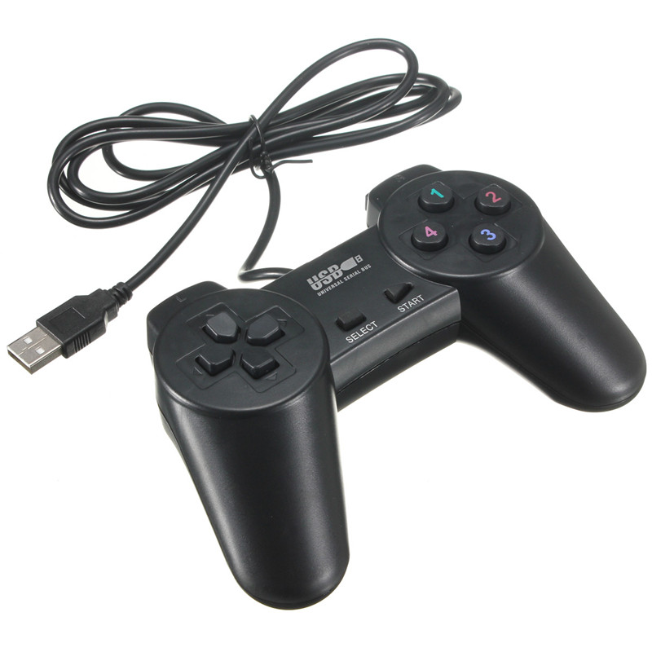
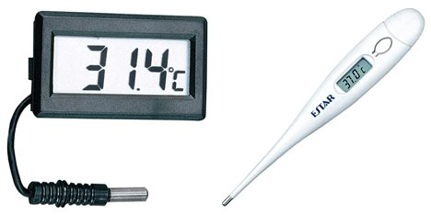
What is Sensor ?
A sensor is a device that measures a physical quantity and converts it into a signal which can be read by an observer or by an instrument.
Sensors are used in everyday objects such as touch-sensitive elevator, buttons (tactile sensor) and lamps which dim or brighten by touching the base.
Example

Slide 15
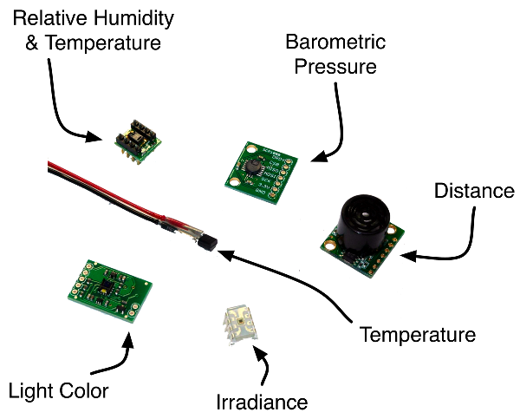
Types of Sensors
Hardware
Sensors
Infrared Proximity Sensor
Sound Sensor
Temperature Sensor
Soil Moisture Sensor
Obstacle detector
Temperature& Humidity Sensor
Pressure Sensor

Slide 16
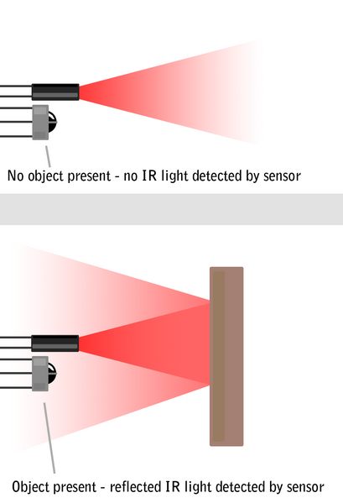
Infrared Proximity Sensor
IR Sensor
Example
IR sensor works on the principle of emitting IR rays and receiving the reflected ray by a receiver (Photo Diode).
IR source (LED) is used in forward bias.
IR Receiver (Photodiode) is used in reverse bias.

Slide 17
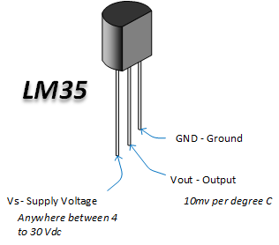
Temperature Sensor LM35
Feature
Example
The LM35 is an integrated circuit sensor that can be used to measure temperature with an electrical output proportional to the temperature (in ºC).
The scale factor is 10mV/ºC .

Slide 18
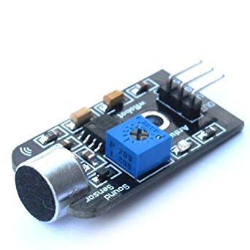
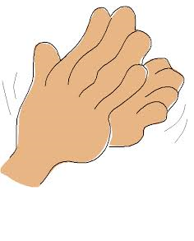
Sound Sensor
Feature
Sound Sensor is a simple microphone transducer based sensor based on the Transistor Amplification which converts from sound energy into electrical energy.
Adjustable range of detection.
Single bit active - high output.
3 - pin male header make it ready to use for breadboard
Example

Slide 19
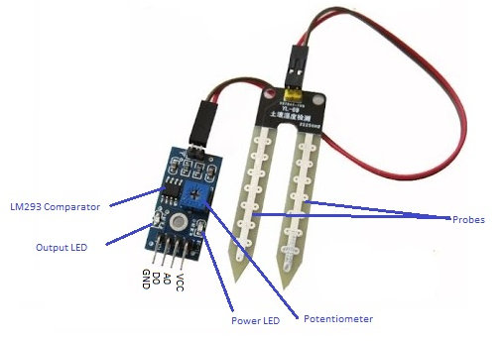
Soil Moisture Sensor
Feature
This soil moisture sensor is used to sense the present of water in soil and gives some output voltage to the processor to execute according to the instruction given by the user.

Slide 20
Feature of Soil Moisture Sensor
Feature
Power supply: 3.3v or 5v
Output voltage signal: 0~4.2v
Current: 35mA
Output – Analog & digital both

Slide 21
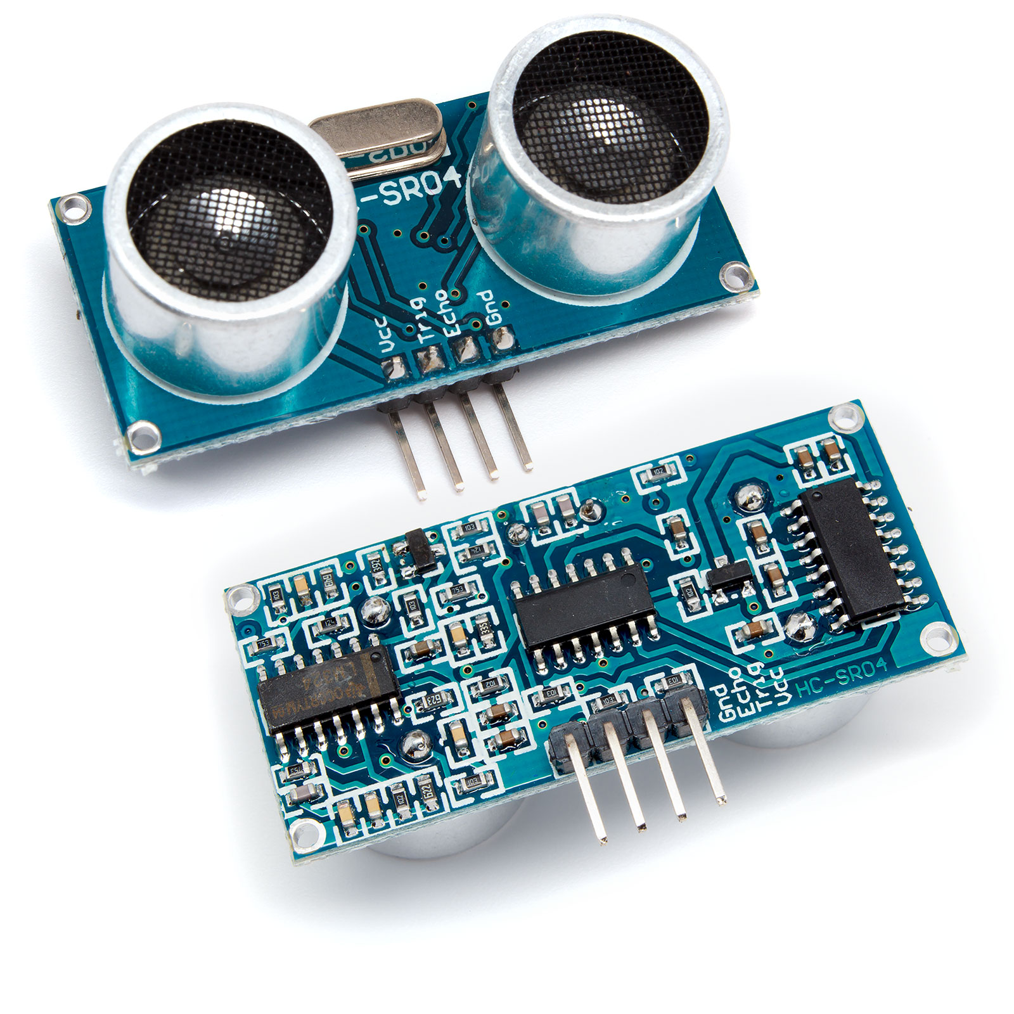
Obstacle Detector HC-SR-04
Feature
Ultra sonic sensor
ultrasonic sensors measure distance by using ultrasonic waves.
The sensor head emits an ultrasonic wave and receives the wave reflected back from the target. Ultrasonic Sensors measure the distance to the target by measuring the time between the emission and reception.

Slide 22
Features of HC-SR-04
Feature
Power Supply :+5V DC
Working Current: 15mA
Measuring Angle: 30 degree
Ranging Distance : 2cm – 400 cm/1″ – 13ft
Trigger Input Pulse width: 10uS
Dimension: 45mm x 20mm x 15mm

Slide 23
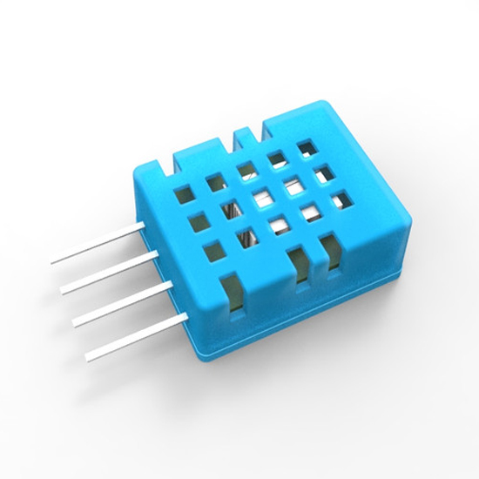
Temperature and Humidity Sensor DHT
Feature
DHT is a low cost Temperature and humidity sensor for electronic hobbyist, who wants to do data logging.
It has on board ADC chip for analog to digital conversion of data.

Slide 24
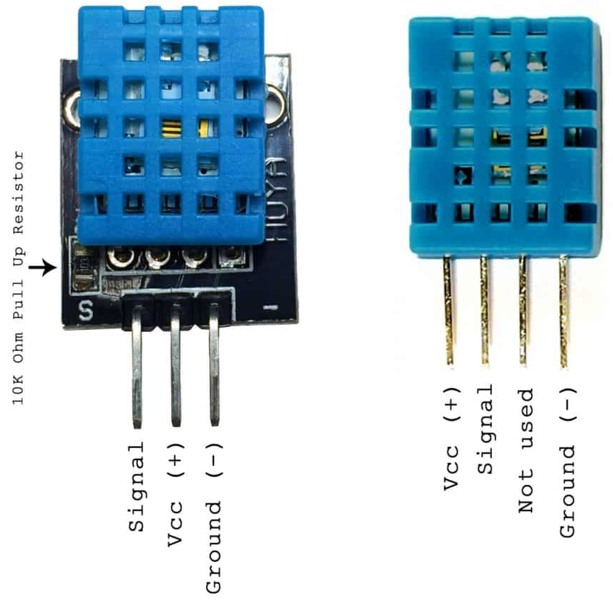
DHT 11
Features
Ultra low cost
3 to 5V power and I/O
2.5mA max current use during conversion (while requesting data)
Good for 20-80% humidity readings with 5% accuracy
Good for 0-50°C temperature readings ±2°C accuracy
No more than 1 Hz sampling rate (once every second).
4 pins with 0.1" spacing

Slide 25
DHT 22
Features
low cost
3 to 5V power and I/O
2.5mA max current use during conversion (while requesting data)
Good for 0-100% humidity readings with 2-5% accuracy
Good for -40 to 125°C temperature readings ±0.5°C accuracy
No more than 0.5 Hz sampling rate (once every 2 seconds)
4 pins with 0.1" spacing

Slide 26
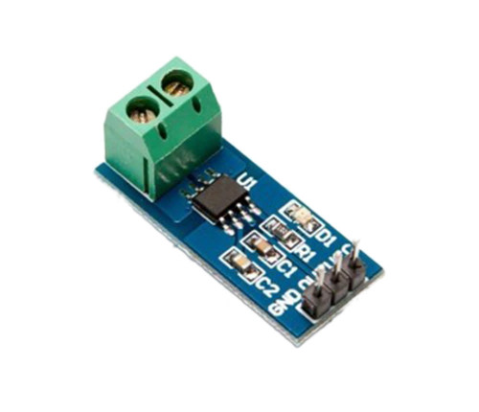
Current Sensor
Features
low cost
The ACS712 is a Fully Integrated, Hall Effect-Based Linear AC/DC Current Sensor with 2.1 kV RMS Voltage Isolation and a Low-Resistance Current Conductor.

Slide 27
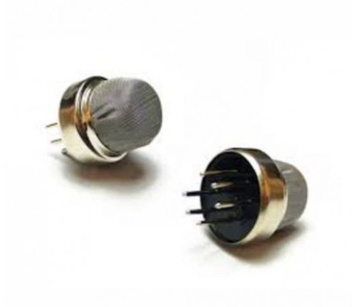
MQ2 LPG Butane Hydrogen Gas Sensor
Features
low cost
The ACS712 is a Fully Integrated, Hall Effect-Based Linear AC/DC Current Sensor with 2.1 kV RMS Voltage Isolation and a Low-Resistance Current Conductor.

Slide 28
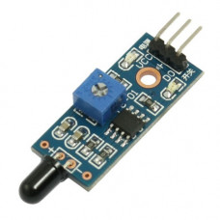
FlameSensor
Features
low cost
1) can detect the flame or wavelength at 760 nm to 760 nm range of light, the lighter the test flame distance is 80 cm, on the flame, the greater the distance test
2) the detection Angle of 60 degrees or so, particularly sensitive to the flame spectrum

Slide 29
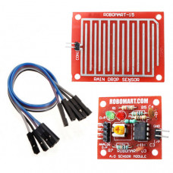
RainDrop Sensor
Features
low cost
The item is for Arduino robot kit, raindrops, rain sensor, monitoring can be used for a variety of weather conditions, and converted into the number of the reference signal and the AO output.

Slide 30
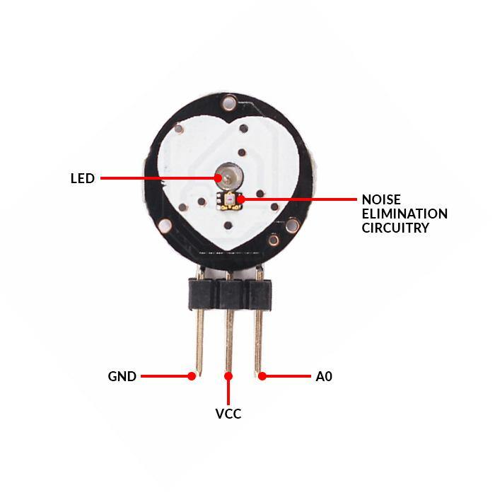
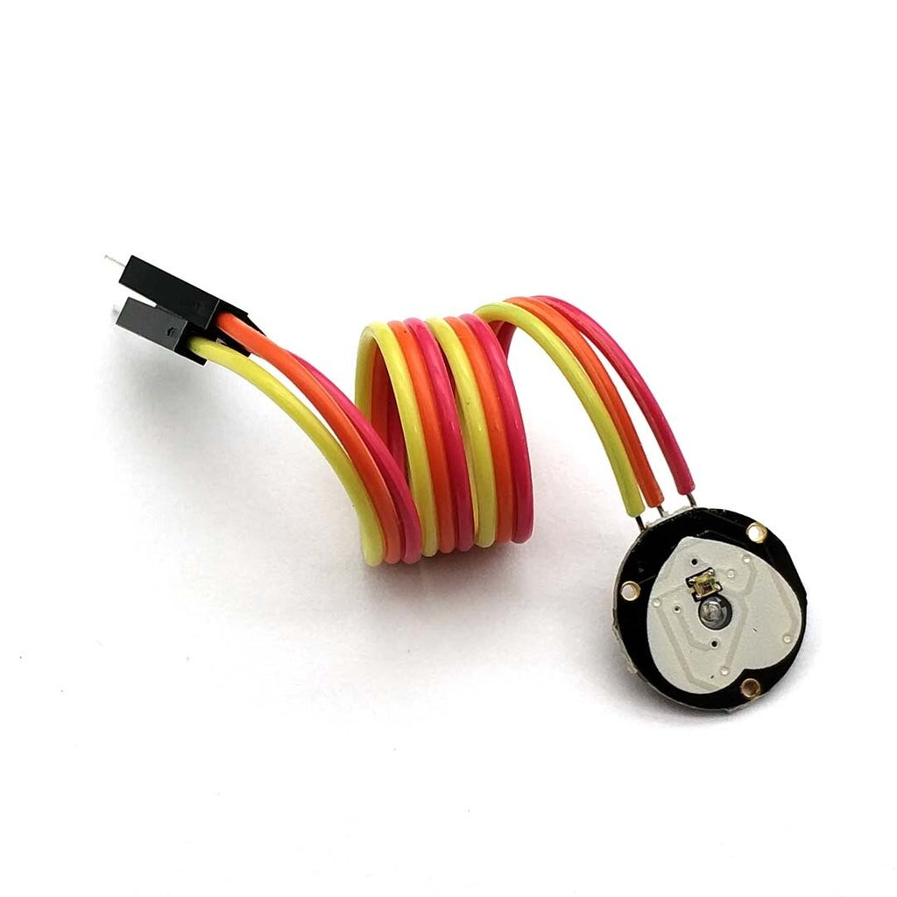
Heartbeat sensor

Slide 31
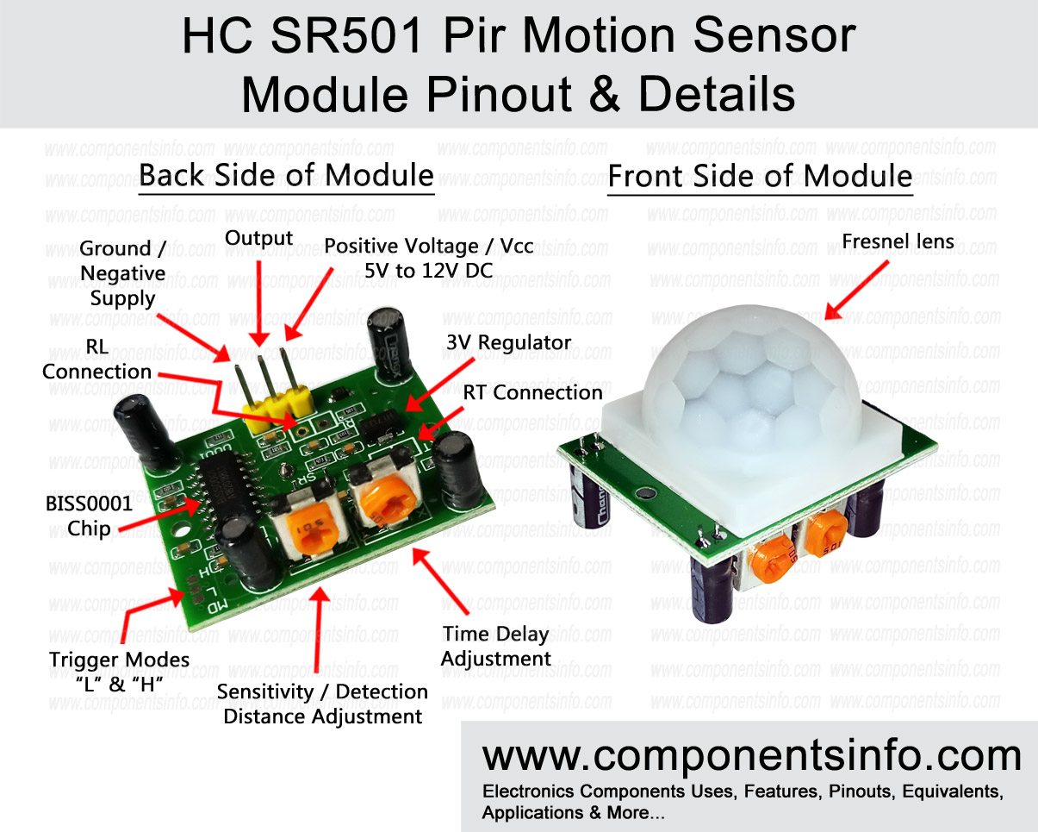
PIR motion sensor

Slide 32
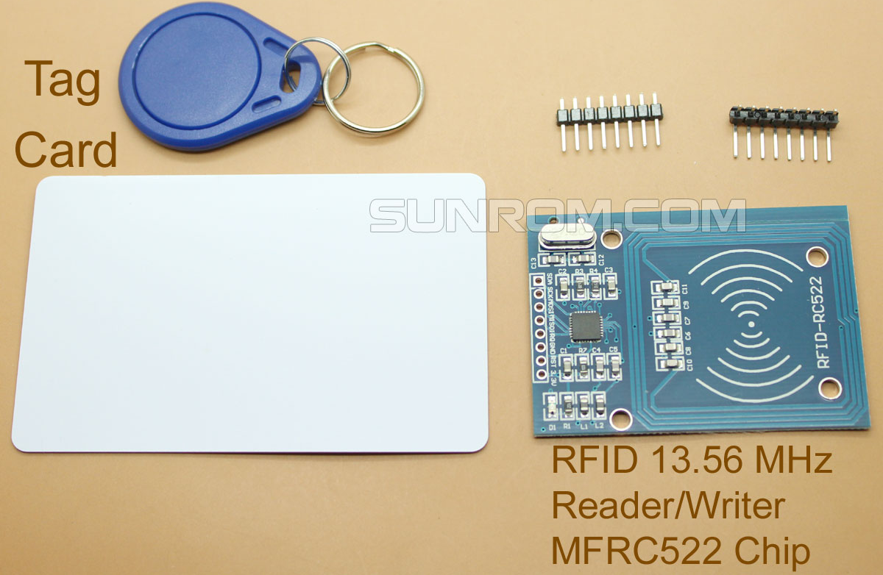
RFID reader

Slide 33
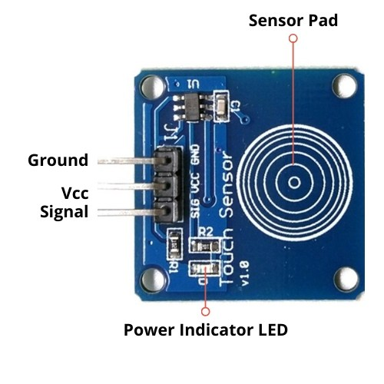
Touch sensor

Slide 34
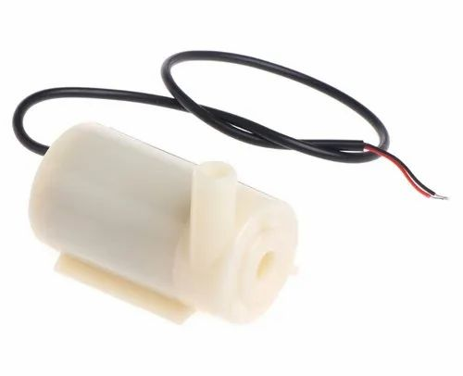
Water motor

Slide 35
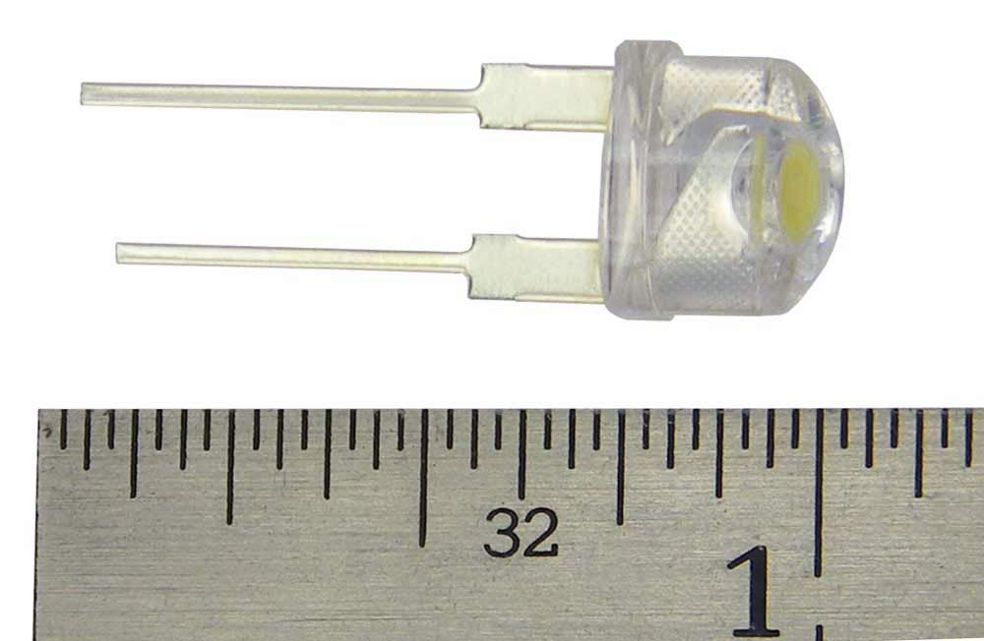
8mm Led bulb

Slide 36
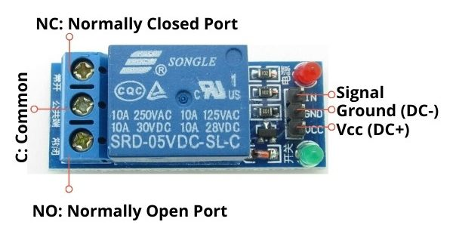
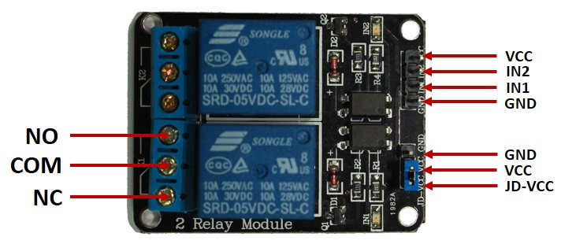
Relay module

Slide 37
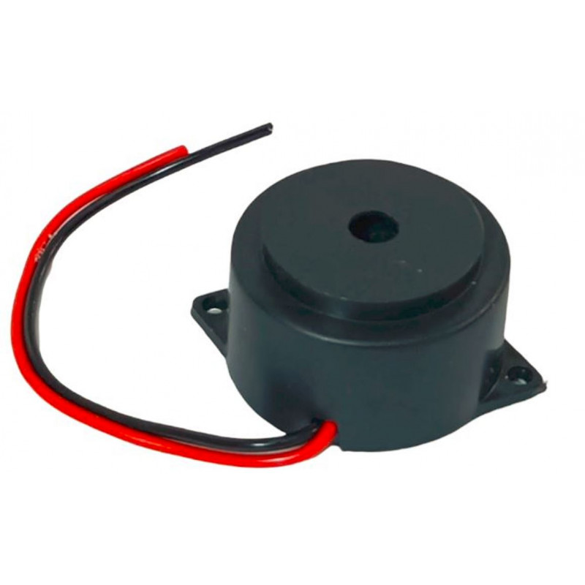
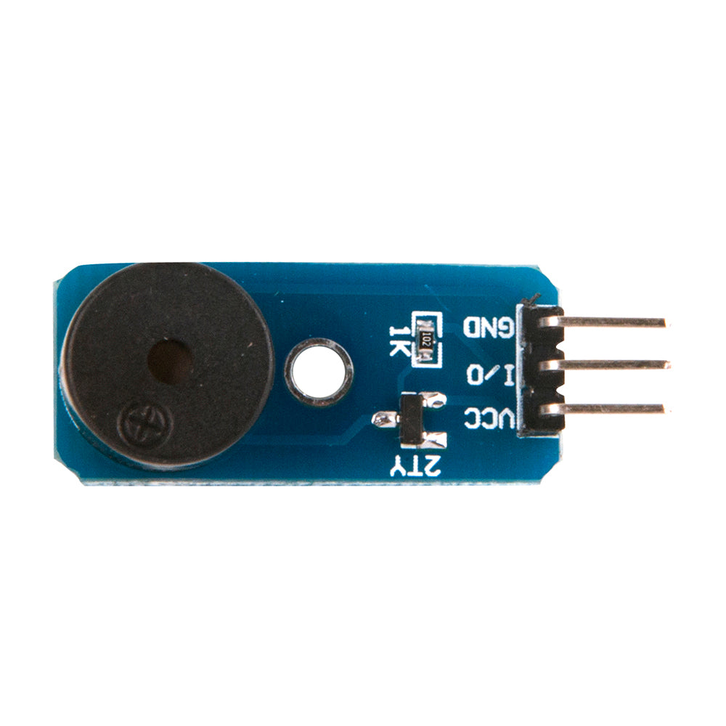
Buzzer

Slide 38
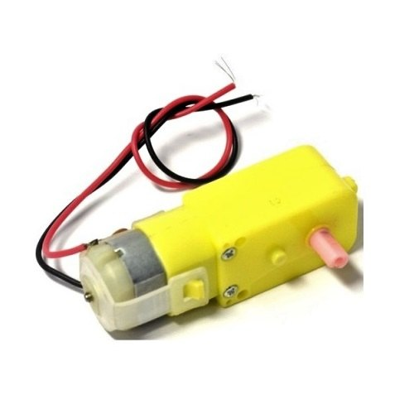
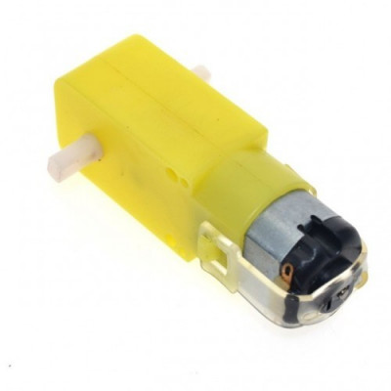
BO Motor

Slide 39
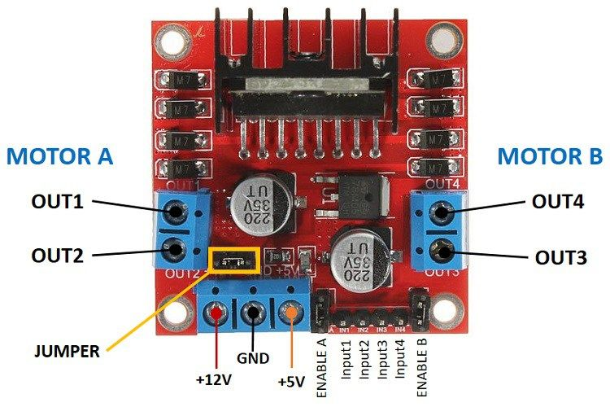
Motor driver

Slide 40


Slide 41


